Slide 1

PROJECT WORK-II PRESENTATION
SESSION: 2022-23
TOPIC: ATTENTION MECHANISM IN DEEP LEARNING
GUIDED BY- MADE BY-
MR. ASHISH KUMAWAT ABHINAV MUKERJI (EN18CS301006)
(MEDI-CAPS UNIVERSITY) ABHISHEK TYAGI (EN18CS301009)
AADARSH RAWAL (EN18CS301001)
DR. SAURABH DAS
(IIT INDORE) CS-A

Slide 2



OFFER LETTER FOR PROJECT WORK-II

Slide 3


Slide 4


PROJECT WORK-II COMPLETION CERTIFICATE

Slide 5


Slide 6
WHAT IS ANN?
Artificial neural networks (ANNs), usually simply called neural networks (NNs), are computing systems inspired by the biological neural networks that constitute animal brains.
An ANN is based on a collection of connected units or nodes called artificial neurons, which loosely model the neurons in a biological brain. Each connection, like the synapses in a biological brain, can transmit a signal to other neurons. An artificial neuron receives a signal then processes it and can signal neurons connected to it.
The "signal" at a connection is a real number, and the output of each neuron is computed by some non-linear function of the sum of its inputs. The connections are called edges. Neurons and edges typically have a weight that adjusts as learning proceeds. The weight increases or decreases the strength of the signal at a connection.
Neurons may have a threshold such that a signal is sent only if the aggregate signal crosses that threshold. Typically, neurons are aggregated into layers. Different layers may perform different transformations on their inputs. Signals travel from the first layer (the input layer), to the last layer (the output layer), possibly after traversing the layers multiple times.

Slide 7
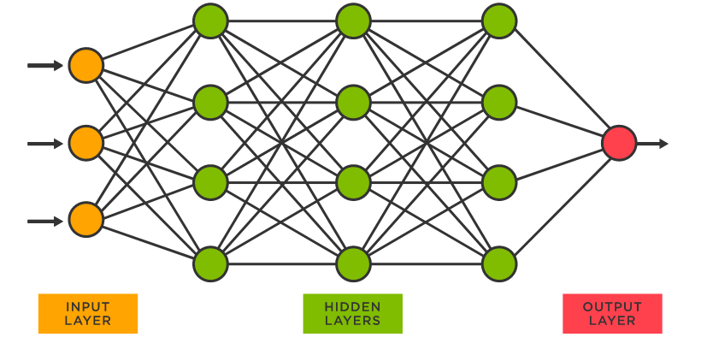

Slide 8
DEEP LEARNING
Deep learning is a machine learning technique that teaches computers to do what comes naturally to humans: learn by example. Deep learning is a key technology behind driverless cars, enabling them to recognize a stop sign, or to distinguish a pedestrian from a lamppost.
It is the key to voice control in consumer devices like phones, tablets, TVs, and hands-free speakers. Deep learning is getting lots of attention lately and for good reason. It’s achieving results that were not possible before.
there are two main reasons it has only recently become useful:
Deep learning requires large amounts of labeled data. For example, driverless car development requires millions of images and thousands of hours of video.
Deep learning requires substantial computing power. High-performance GPUs have a parallel architecture that is efficient for deep learning. When combined with clusters or cloud computing, this enables development teams to reduce training time for a deep learning network from weeks to hours or less.

Slide 9
ARTIFICIAL NEURON
ANNs are composed of artificial neurons which are conceptually derived from biological neurons. Each artificial neuron has inputs and produces a single output which can be sent to multiple other neurons.The inputs can be the feature values of a sample of external data, such as images or documents, or they can be the outputs of other neurons. The outputs of the final output neurons of the neural net accomplish the task, such as recognizing an object in an image.
To find the output of the neuron, First we must take the weighted sum of all the inputs, weighted by the weights of the connections from the inputs to the neuron. We add a bias term to this sum.This weighted sum is sometimes called the activation. The initial inputs are external data, such as images and documents. The ultimate outputs accomplish the task, such as recognizing an object in an image.

Slide 10
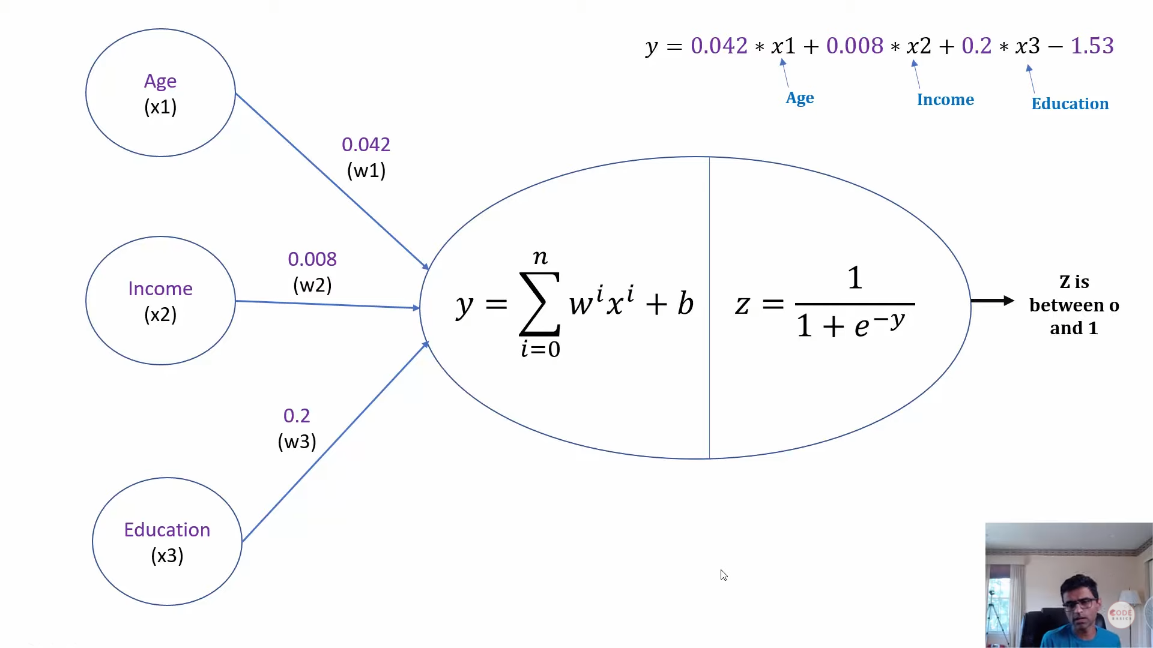
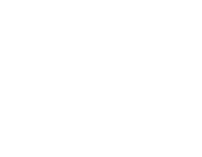

Slide 11
LEARNING
Learning is the adaptation of the network to better handle a task by considering sample observations. Learning involves adjusting the weights (and optional thresholds) of the network to improve the accuracy of the result. This is done by minimizing the observed errors. Learning is complete when examining additional observations does not usefully reduce the error rate. Even after learning, the error rate typically does not reach 0. If after learning, the error rate is too high, the network typically must be redesigned. Practically this is done by defining a cost function that is evaluated periodically during learning. As long as its output continues to decline, learning continues. The cost is frequently defined as a statistic whose value can only be approximated. Learning attempts to reduce the total of the differences across the observations. Most learning models can be viewed as a straightforward application of optimization theory and statistical estimation.[

Slide 12
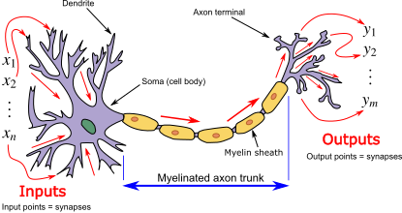

Slide 13
ACTIVATION FUNCTION IN ANN
An activation function is a function used in artificial neural networks which outputs a small value for small inputs, and a larger value if its inputs exceed a threshold. If the inputs are large enough, the activation function "fires", otherwise it does nothing. In other words, an activation function is like a gate that checks that an incoming value is greater than a critical number.
Activation functions are useful because they add non-linearities into neural networks, allowing the neural networks to learn powerful operations. If the activation functions were to be removed from a feedforward neural network, the entire network could be refactored to a simple linear operation or matrix transformation on its input, and it would no longer be capable of performing complex tasks such as image recognition.

Slide 14
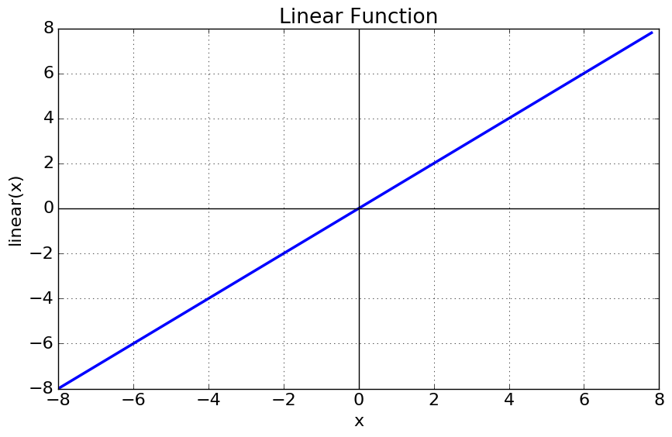
VARIANTS OF ACTIVATION FUNCTION
1). Linear Function :-
Equation : Linear function has the equation similar to as of a straight line i.e. y = ax
No matter how many layers we have, if all are linear in nature, the final activation function of last layer is nothing but just a linear function of the input of first layer.
Range : -inf to +inf
Uses : Linear activation function is used at just one place i.e. output layer.
Issues : If we will differentiate linear function to bring non-linearity, result will no more depend on input “x” and function will become constant, it won’t introduce any ground-breaking behavior to our algorithm.

Slide 15
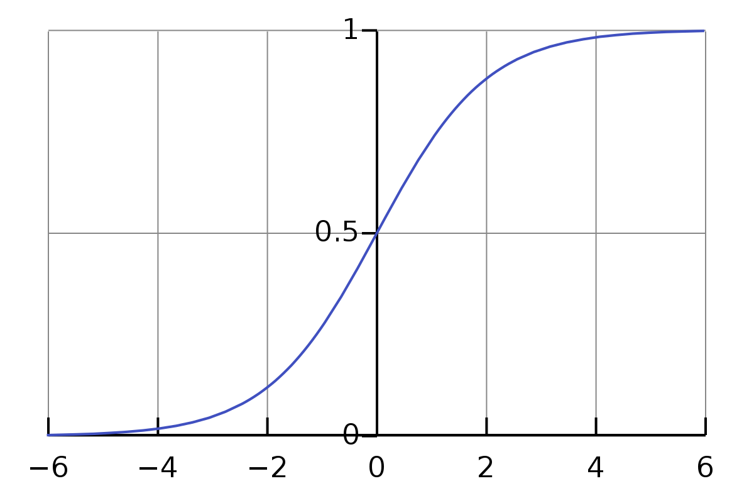
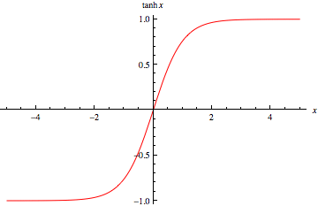
2). Sigmoid Function :-
It is a function which is plotted as ‘S’ shaped graph.
Equation : A = 1/(1 + e-x)
Nature : Non-linear. Notice that X values lies between -2 to 2, Y values are very steep. This means, small changes in x would also bring about large changes in the value of Y.
Value Range : 0 to 1
3). Tanh Function :- The activation that works almost always better than sigmoid function is Tanh function also known as Tangent Hyperbolic function. It’s actually mathematically shifted version of the sigmoid function. Both are similar and can be derived from each other.

Slide 16
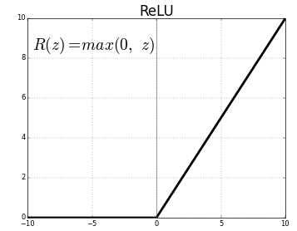
4). RELU :- Stands for Rectified linear unit. It is the most widely used activation function. Chiefly implemented in hidden layers of Neural network.
Equation :- A(x) = max(0,x). It gives an output x if x is positive and 0 otherwise.
Value Range :- [0, inf)
Nature :- non-linear, which means we can easily backpropagate the errors and have multiple layers of neurons being activated by the ReLU function.
Uses :- ReLu is less computationally expensive than tanh and sigmoid because it involves simpler mathematical operations. At a time only a few neurons are activated making the network sparse making it efficient and easy for computation.

Slide 17
5). Softmax Function :- The softmax function is also a type of sigmoid function but is handy when we are trying to handle classification problems.
Nature :- non-linear
Uses :- Usually used when trying to handle multiple classes. The softmax function would squeeze the outputs for each class between 0 and 1 and would also divide by the sum of the outputs.
Output:- The softmax function is ideally used in the output layer of the classifier where we are actually trying to attain the probabilities to define the class of each input. CHOOSING THE RIGHT ACTIVATION FUNCTION
The basic rule of thumb is if you really don’t know what activation function to use, then simply use RELU as it is a general activation function and is used in most cases these days. If your output is for binary classification then, sigmoid function is very natural choice for output layer.

Slide 18
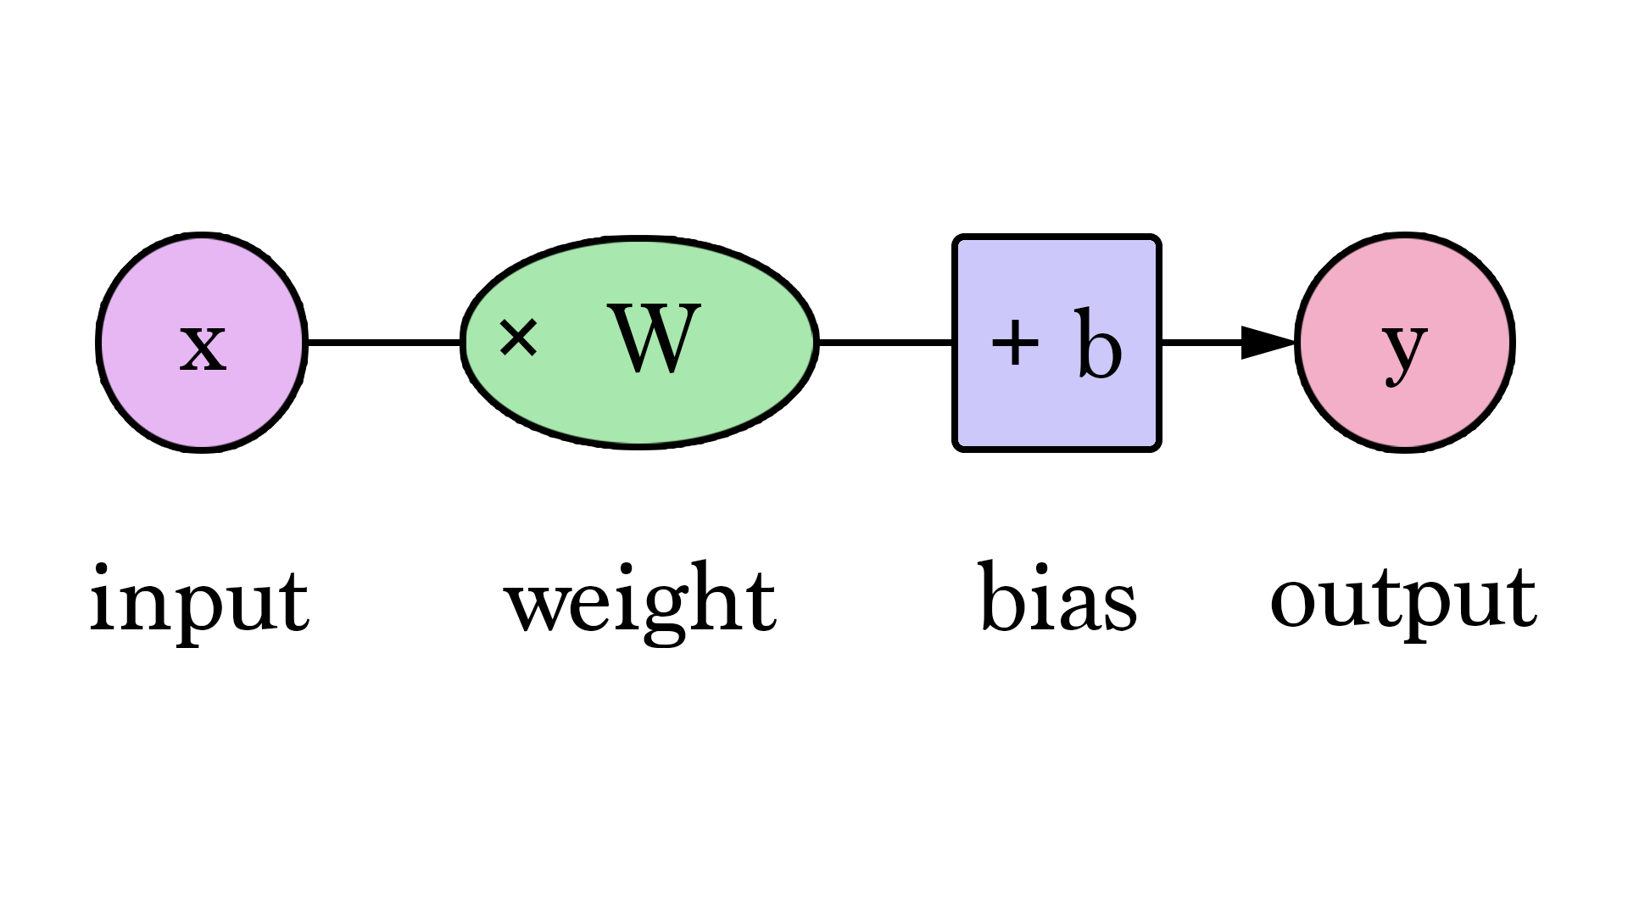
Weights in ANN
What is Weight (Artificial Neural Network)?
Weight is the parameter within a neural network that transforms input data within the network's hidden layers. A neural network is a series of nodes, or neurons. Within each node is a set of inputs, weight, and a bias value. As an input enters the node, it gets multiplied by a weight value and the resulting output is either observed, or passed to the next layer in the neural network. Often the weights of a neural network are contained within the hidden layers of the network.

Slide 19
WHY CNN OVER ANN?
A ConvNet is able to successfully capture the Spatial and Temporal dependencies in an image through the application of relevant filters. The architecture performs a better fitting to the image dataset due to the reduction in the number of parameters involved and reusability of weights. In other words, the network can be trained to understand the sophistication of the image better.

Slide 20
CNN
A Convolutional Neural Network (ConvNet/CNN) is a Deep Learning algorithm which can take in an input image, assign importance (learnable weights and biases) to various aspects/objects in the image and be able to differentiate one from the other. The pre-processing required in a ConvNet is much lower as compared to other classification algorithms. While in primitive methods filters are hand-engineered, with enough training, ConvNets have the ability to learn these filters/characteristics.

Slide 21
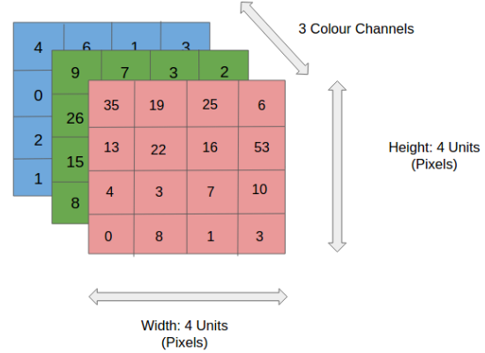
In the figure, we have an RGB image which has been separated by its three color planes — Red, Green, and Blue. There are a number of such color spaces in which images exist — Grayscale, RGB, HSV, CMYK, etc.You can imagine how computationally intensive things would get once the images reach dimensions, say 8K (7680×4320). The role of the ConvNet is to reduce the images into a form which is easier to process, without losing features which are critical for getting a good prediction. This is important when we are to design an architecture which is not only good at learning features but also is scalable to massive datasets.

Slide 22
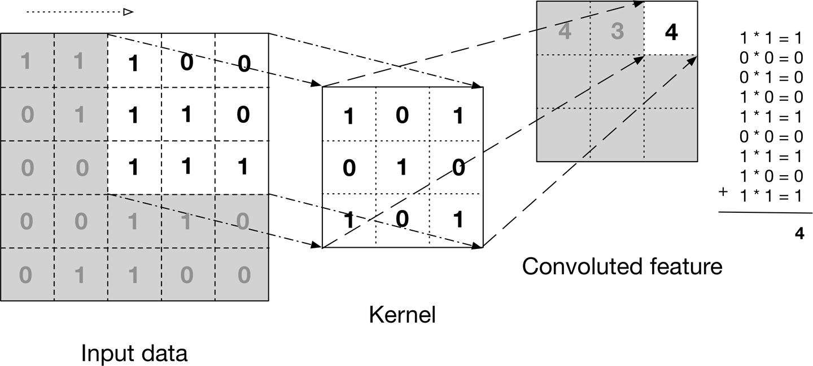

Slide 23
CNN PADDING
Problem with Simple Convolution Layers
For a gray scale (n x n) image and (f x f) filter/kernel, the dimensions of the image resulting from a convolution operation is (n – f + 1) x (n – f + 1). For example, for an (8 x 8) image and (3 x 3) filter, the output resulting after convolution operation would be of size (6 x 6). Thus, the image shrinks every time a convolution operation is performed. This places an upper limit to the number of times such an operation could be performed before the image reduces to nothing thereby precluding us from building deeper networks.
Also, the pixels on the corners and the edges are used much less than those in the middle.

Slide 24
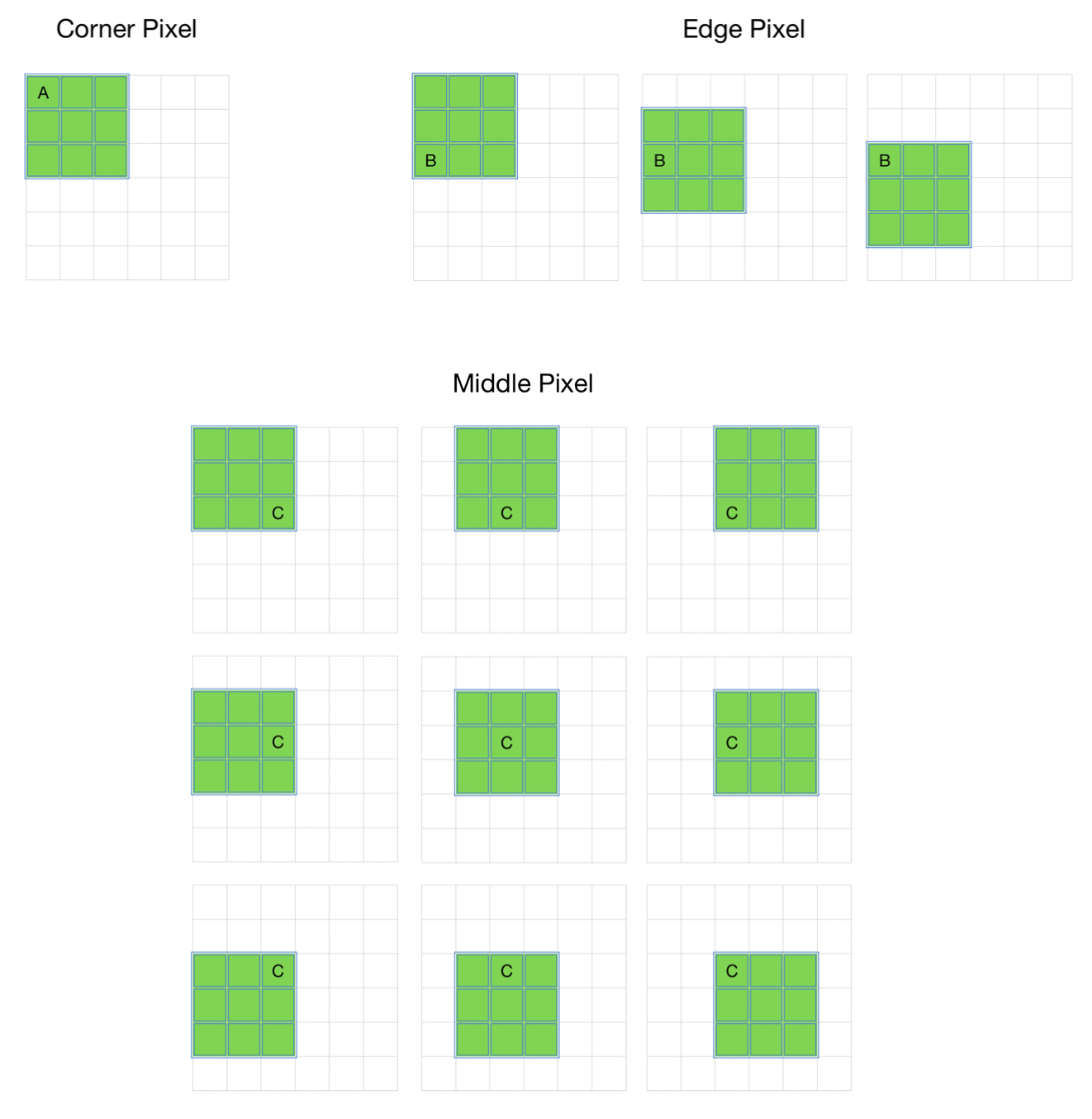
Clearly, pixel A is touched in just one convolution operation and pixel B is touched in 3 convolution operations, while pixel C is touched in 9 convolution operations. In general, pixels in the middle are used more often than pixels on corners and edges. Consequently, the information on the borders of images is not preserved as well as the information in the middle.

Slide 25
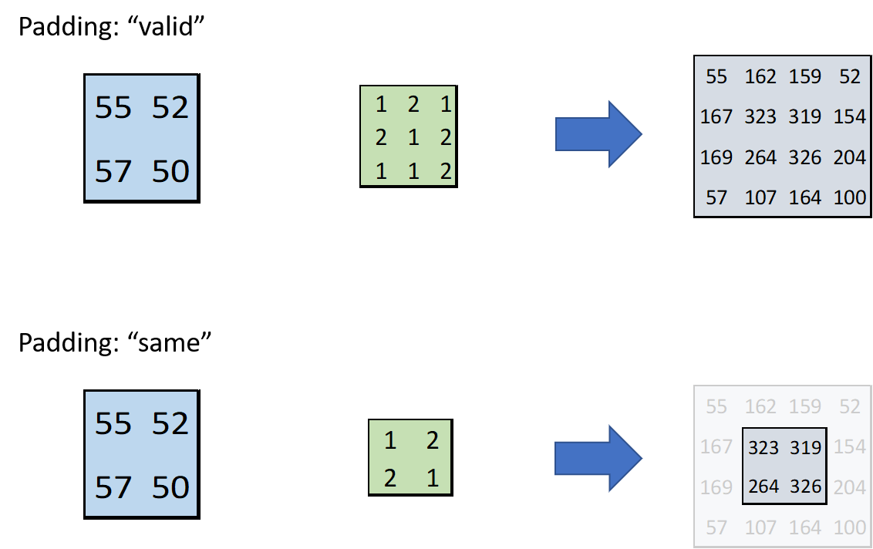
1) Valid Padding: It implies no padding at all. The input image is left in its valid/unaltered shape.
2) Same Padding: In this case, we add ‘p’ padding layers such that the output image has the same dimensions as the input image.

Slide 26
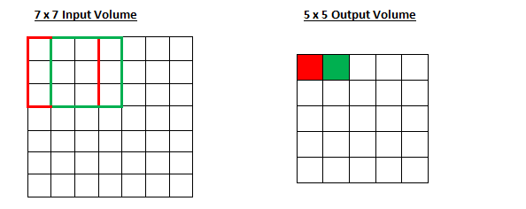
STRIDE IN CNN
Stride is a component of convolutional neural networks, or neural networks tuned for the compression of images and video data. Stride is a parameter of the neural network's filter that modifies the amount of movement over the image or video. For example, if a neural network's stride is set to 1, the filter will move one pixel, or unit, at a time. The size of the filter affects the encoded output volume, so stride is often set to a whole integer, rather than a fraction or decimal.

Slide 27
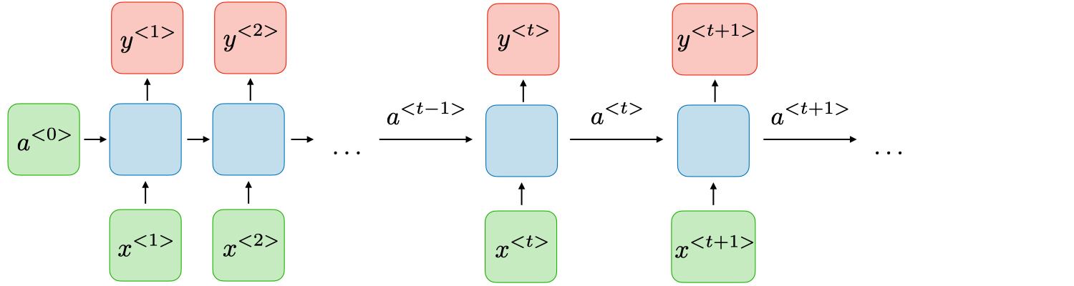
RNN (Recurrent Neural Networks)
A recurrent neural network (RNN) is a type of artificial neural network which uses sequential data or time series data.
These deep learning algorithms are commonly used for ordinal or temporal problems, such as language translation, natural language processing (nlp), speech recognition, and image captioning; they are incorporated into popular applications such as Siri, voice search, and Google Translate.
They are distinguished by their “memory” as they take information from prior inputs to influence the current input and output

Slide 28
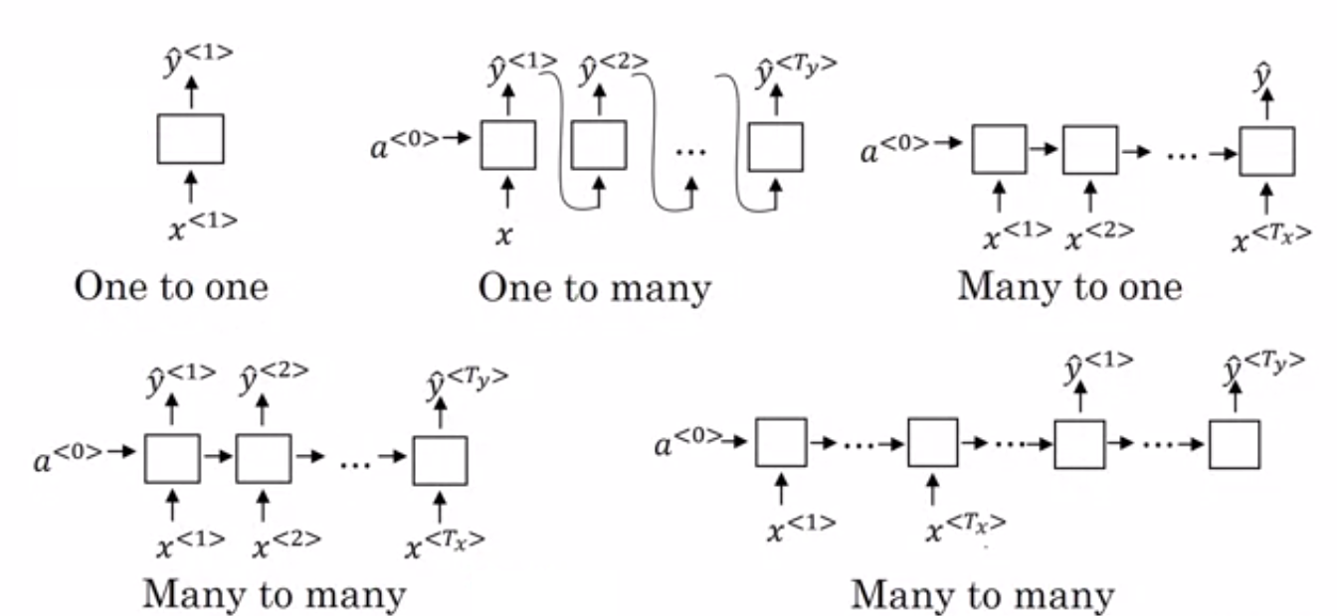

Slide 29
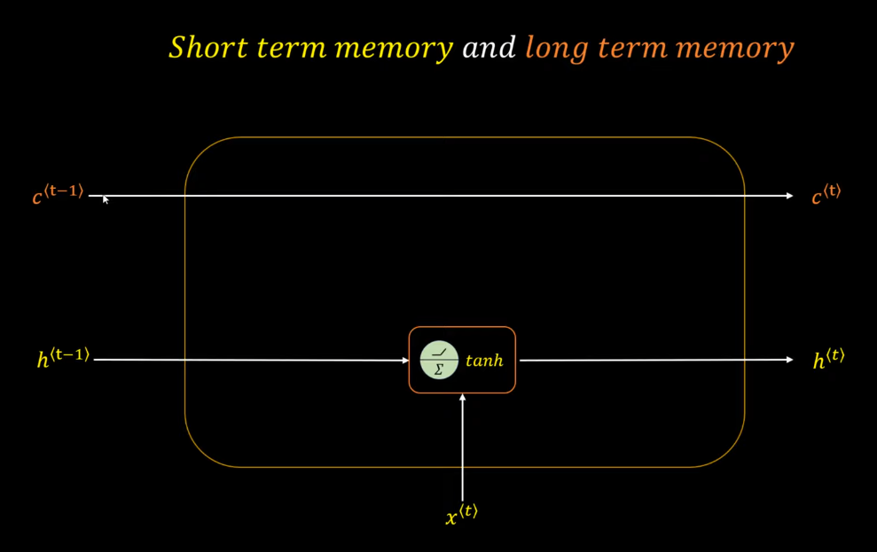
LONG SHORT TERM MEMORY (LSTM)
When we arrange our calendar for the day, we prioritize our appointments right? If in case we need to make some space for anything important we know which meeting could be canceled to accommodate a possible meeting.Turns out that an RNN doesn’t do so. In order to add a new information, it transforms the existing information completely by applying a function. Because of this, the entire information is modified, on the whole, i. e. there is no consideration for ‘important’ information and ‘not so important’ information.LSTMs on the other hand, make small modifications to the information by multiplications and additions. With LSTMs, the information flows through a mechanism known as cell states. This way, LSTMs can selectively remember or forget things. The information at a particular cell state has three different dependencies.

Slide 30
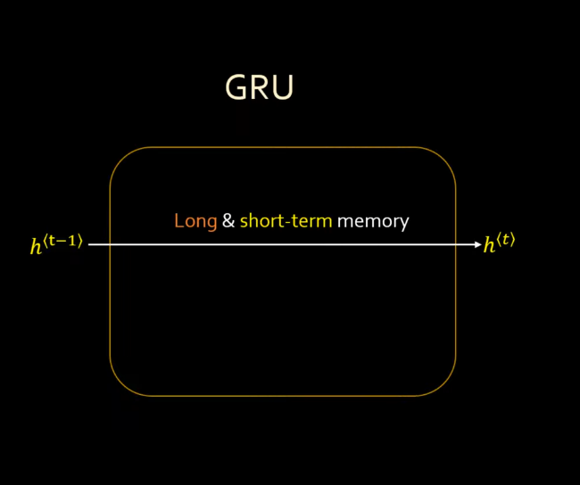
GRU
The workflow of the Gated Recurrent Unit, in short GRU, is the same as the RNN but the difference is in the operation and gates associated with each GRU unit. To solve the problem faced by standard RNN, GRU incorporates the two gate operating mechanisms called Update gate and Reset gate.
Update gate- The update gate is responsible for determining the amount of previous information that needs to pass along the next state.
Reset gate- The reset gate is used from the model to decide how much of the past information is needed to neglect; in short, it decides whether the previous cell state is important or not.

Slide 31
Encoder & Decoder
The Encoder Block
The encoder part is an LSTM cell. It is fed in the input-sequence over time and it tries to encapsulate all its information and store it in its final internal states hₜ (hidden state) and cₜ (cell state). The internal states are then passed onto the decoder part, which it will use to try to produce the target-sequence. This is the ‘context vector’ which we were earlier referring to.
The Decoder Block
Unlike encoders, decoders unfold a vector representing the sequence state and return something meaningful for us like text, tags, or labels. An essential distinction with encoders is that decoders require both, the hidden state and the output from the previous state. When the decoder starts processing, there’s no previous output, so we use a special token <start> for those cases. Let’s make it clearer with the example below, which shows how machine translation works:

Slide 32
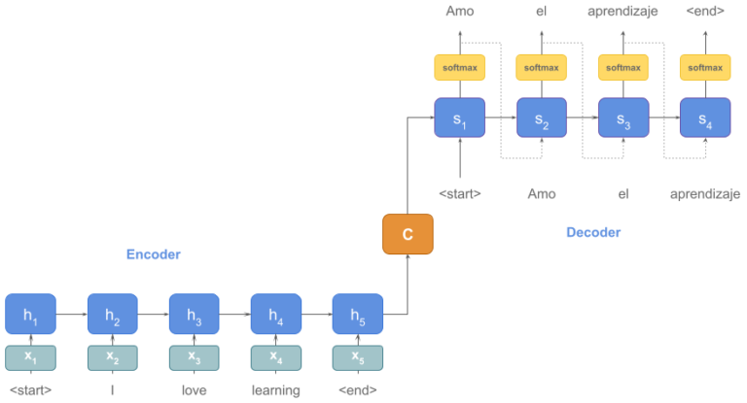
DRAWBACKS
Long sentences face the problem of context remembrance.
There is reduction of Bleu score on increasing the sentence length.
W context vector mostly holds the context of last few words only.

Slide 33
ATTENTION MECHANISM
A potential issue with this encoder–decoder approach is that a neural network needs to be able to compress all the necessary information of a source sentence into a fixed-length vector. This may make it difficult for the neural network to cope with long sentences, especially those that are longer than the sentences in the training corpus.In order to address this issue, we introduce an extension to the encoder–decoder model which learns to align and translate jointly.
Each time the proposed model generates a word in a translation, it (soft-)searches for a set of positions in a source sentence where the most relevant information is concentrated. The model then predicts a target word based on the context vectors associated with these source positions and all the previous generated target words.

Slide 34
The most important distinguishing feature of this approach from the basic encoder–decoder is that it does not attempt to encode a whole input sentence into a single fixed-length vector. Instead, it encodes the input sentence into a sequence of vectors and chooses a subset of these vectors adaptively while decoding the translation. This frees a neural translation model from having to squash all the information of a source sentence, regardless of its length, into a fixed-length vector. We show this allows a model to cope better with long sentences. In this paper, we show that the proposed approach of jointly learning to align and translate achieves significantly improved translation performance over the basic encoder–decoder approach.
The improvement is more apparent with longer sentences, but can be observed with sentences of any length. On the task of English-to-French translation, the proposed approach achieves, with a single model, a translation performance comparable, or close, to the conventional phrase-based system. Furthermore, qualitative analysis reveals that the proposed model finds a linguistically plausible (soft-)alignment between a source sentence and the corresponding target sentence.

Slide 35
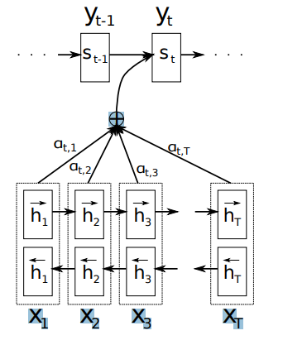

DECODER
In a new model architecture, we define each conditional probability as:
p(yi |y1, . . . , yi−1, x) = g(yi−1, si , ci),
where si is an RNN hidden state for time i, computed by
si = f(si−1, yi−1, ci).
It should be noted that unlike the existing encoder–decoder approach, here the probability is conditioned on a distinct context vector ci for each target word yi . The context vector ci depends on a sequence of annotations (h1, · · · , hTx ) to which an encoder maps the input sentence. Each annotation hi contains information about the whole input sequence with a strong focus on the parts surrounding the i-th word of the input sequence. We explain in detail how the annotations are computed in the next section. The context vector ci is, then, computed as a weighted sum of these annotations hi :

Slide 36


The weight αij of each annotation hj is computed by:
Where,
is an alignment model which scores how well the inputs around position j and the output at position i match. The score is based on the RNN hidden state si−1 and the j-th annotation hj of the input sentence. We parametrize the alignment model a as a feedforward neural network which is jointly trained with all the other components of the proposed system

Slide 37
ENCODER
The usual RNN, as described, reads an input sequence x in order starting from the first symbol x1 to the last one xTx . However, in the proposed scheme, we would like the annotation of each word to summarize not only the preceding words, but also the following words. Hence, we propose to use a bidirectional RNN (BiRNN, Schuster and Paliwal, 1997), which has been successfully used recently in speech recognition.

Slide 38
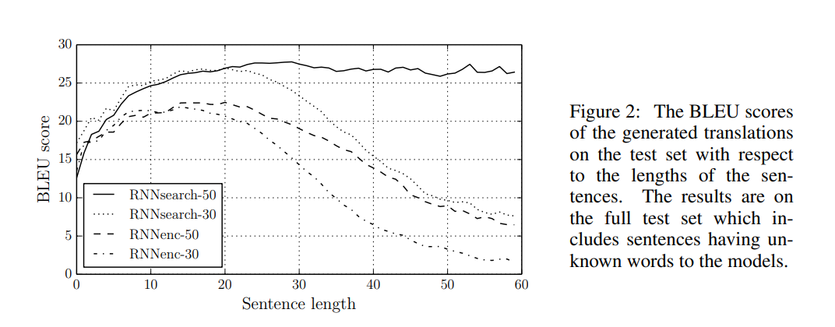
BLEU SCORE IMPACT

Slide 39
THANK YOU !

